Slide 1
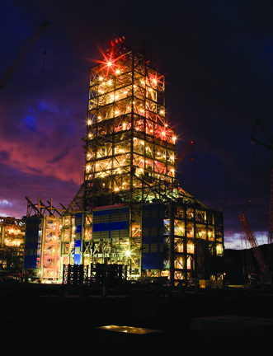
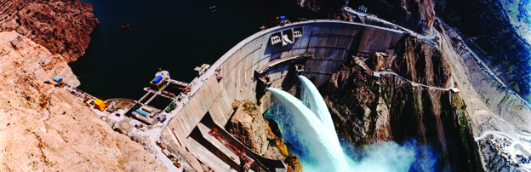
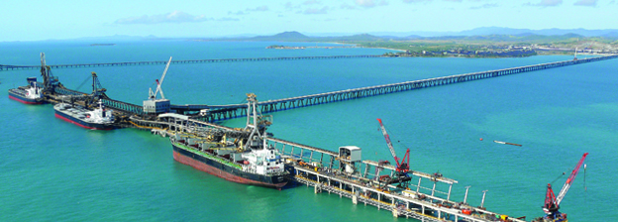
A Fully Integrated Model for the Optimal Operation of HydroPower Generation
by Francois Welt
University of Toronto, Dec. 4, 2012

Slide 2

Hatch Power and Water Optimization Group
Engineering Company
Specialized group within Hatch Renewable Power
Experience:
  Over 40 systems implemented
  Experience with different types of hydro systems
Supported by over 9,000 multi-disciplinary engineering professionals worldwide
Notes:
Francois and Stu: Please verify the number of systems implemented
Brad, this is a good place to speak about any other Hatch facts that you think might be relevant to the PT Inco team

Slide 3
Hatch Power and Water Optimization
Water Resource and Power System Modeling – Simulation and Optimization
System Implementation
  Configuration, Test
  Integration / Communications
  Install and Train
Studies
Asset Management / Life cycle analysis
Wind Farm Design Optimization
Notes:
Francois and Stu: Please verify the number of systems implemented
Brad, this is a good place to speak about any other Hatch facts that you think might be relevant to the PT Inco team

Slide 4
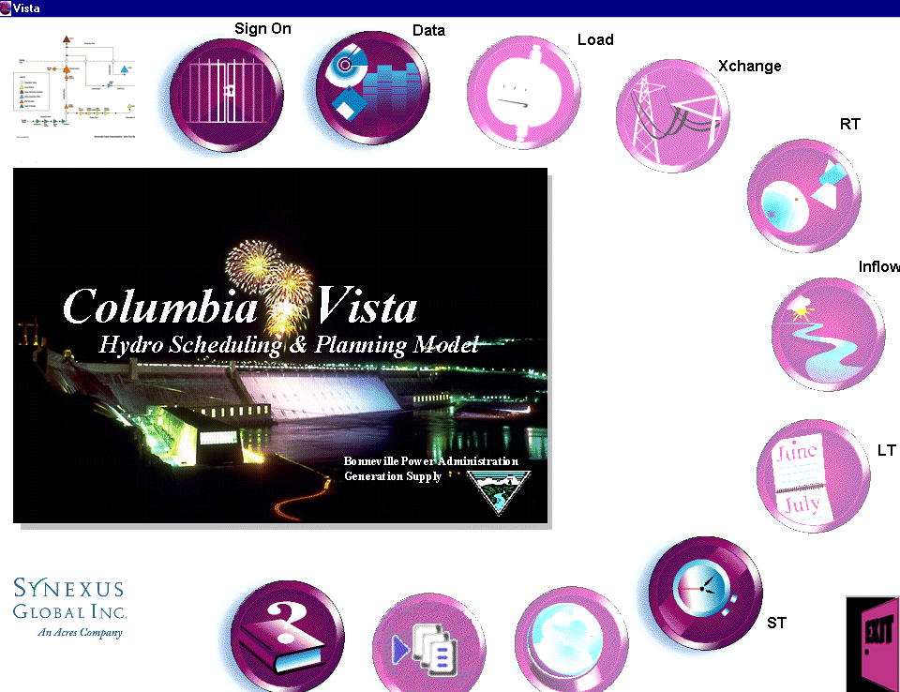
Columbia Vista - Integrated Optimization Model

Slide 5
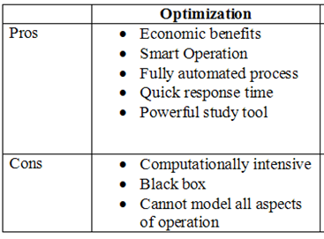
Hydro Optimization in Generation Planning
Concepts
Make best use of limited hydro resources
Meet operational constraints
Maximize Profits
  Maximize sales/ Minimize costs
  Calculate optimal plant/unit MW
  Calculate optimal WL trajectory/ spill releases
  Calculate bid curve
Optimization technologies becoming increasingly attractive with improvements in computing speeds/ capabilities
Notes:
Actual scheme of the PT Inco hydro system in Sorowako
The goal of any hydro system is to produce reliable energy while avoiding waste
Click one: Here we see the hydro system beyond it’s capacity – there will be spillage when it rains
Click two: During the dry season there is a risk of having insufficient water – during this time operations rely on thermal energy
Click three: The objective of Vista DSS is to prevent spillage and maintain water reservoirs at a level that addressed long term energy needs – here we can see a well balanced system that can accommodate additional rain and maintain operations during a water shortage

Slide 6
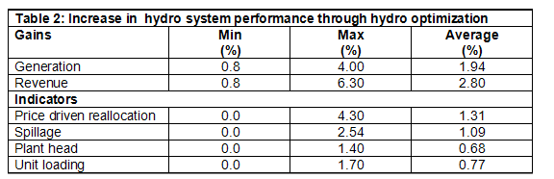
Optimization Statistics
Examples of potential economic benefits from optimization - Short term operation
Ref: “Assessing the Economic Benefits of Implementing Hydro Optimization”,
Hydro Review magazine, 1998
Typically, potential improvements between 1 – 5%

Slide 7
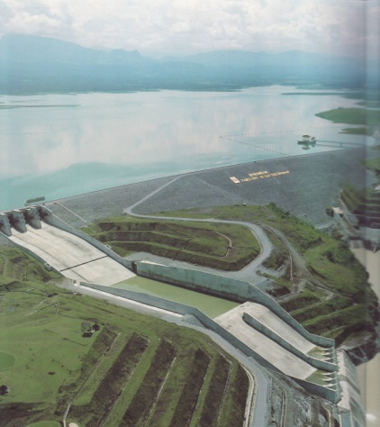
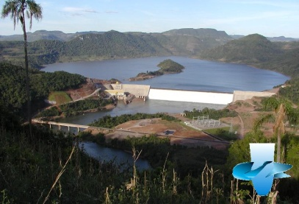

Hydro Optimization
Time Scale
Plant/ units
Smaller reservoir
Larger reservoir
Long Term (LT):
Generation/Water Plan
Targets and Water Values
Short Term (ST):
Schedule
Transactions
Real Time (RT):
Dispatch
Hour/day end/
To end of week/month
To end of water year

Slide 8
Optimization Problem
Must formulate problem in terms of:
  Objective functions
  Constraints
    Rules of operation
    Physical relations
  Decision Variables
Characteristics:
One set of decisions per time step, piece of equipment
Hydraulic network
Transmission network
Large problem size

Slide 9
Physical Representation
Hydraulic Network
  Source: Inflow Points
  Sink: downstream outlet
  Water conveyance/ Flow
  Storage
  Head (Potential energy) and head loss
  Can be bi-directional (gen/pump)
Electric Network
  Source: Generation points
  Sink: Load or Market points
  Bi-directional
  Energy losses

Slide 10
Hydro System Components
River
Reach
Inflow Arc
Reservoir Node
Power Arc
Spill Arc
Tailwater Junction Node
River
Reach

Slide 11
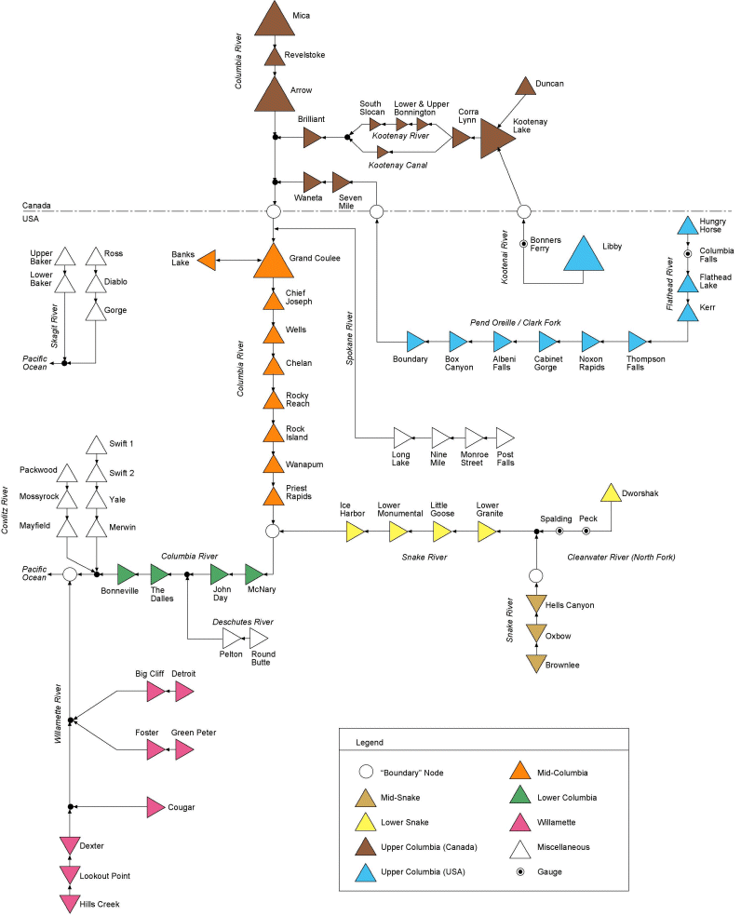
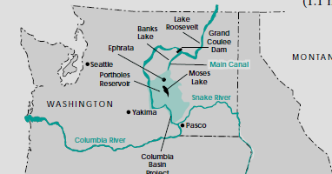
Columbia
River
System

Slide 12
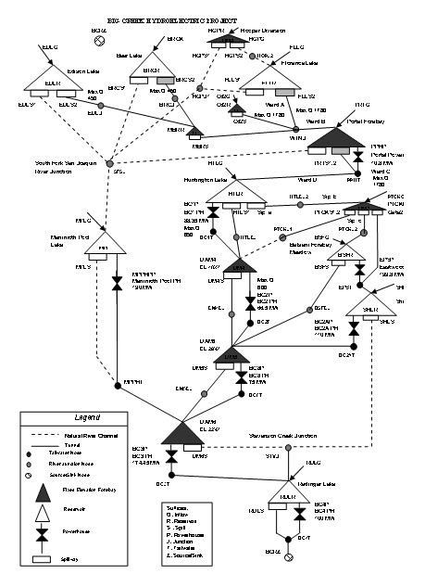
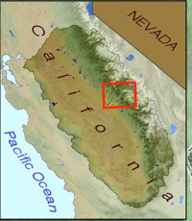
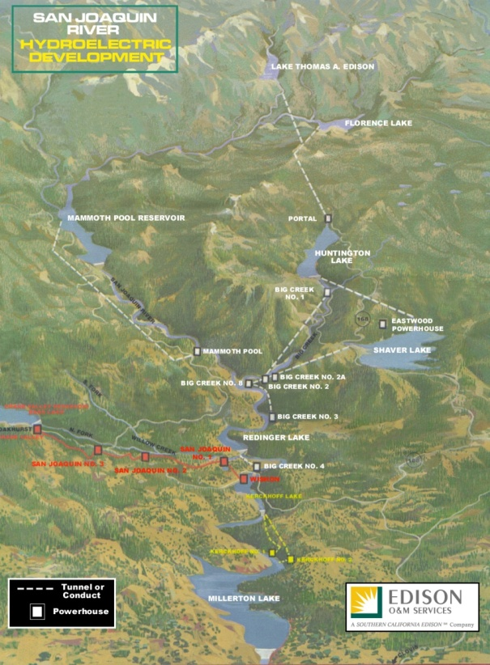
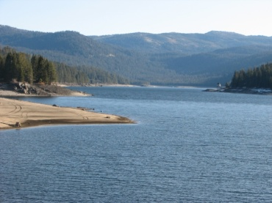
SCE Vista
Big Creek Hydro System Representation

Slide 13
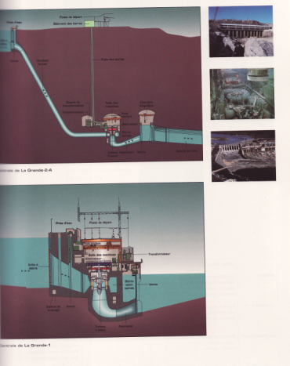
Generation Resource
(Hydraulic flow to Electric MW)

Slide 14
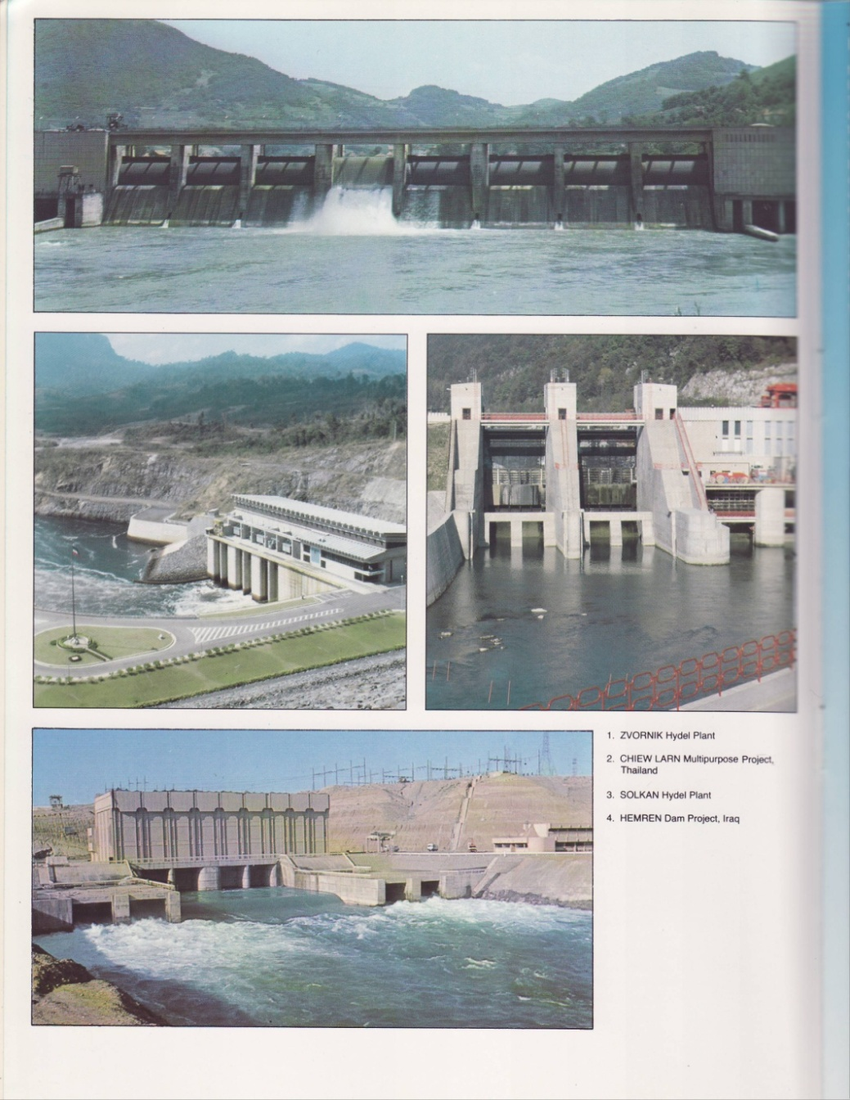
Controlled and Uncontrolled Spillways

Slide 15
Rock Island Schematic
Powerhouse Two
Powerhouse One
Spillway
8
8
8
8
8
8
8
8
8
8
8
8
8
8
8
8
8
8
F
F
F

Slide 16
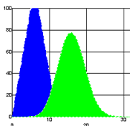
Hydraulic Network Representation
  Continuity equation at each reservoir node
  Σ Qin – ΣQout = V(t) – V(t-1)
  Continuity equation at each junction node
  Σ Qin – ΣQout = 0
  Conveyance in reach arc
  Qout (t) = Σ α(n).Qin(t-n)

Slide 17
Transmission Area
D
Transaction
Load Demand
Committed Transactions
X
X
H
Hydro Generation
Market
Purchase
Sale
Bilateral
Purchase
Sale
T
Thermal Generation
Wind
Wind
Generation

Slide 18
Bus Configuration
“aggregate
unit”
COB2P
Contract Bus
Supply Area
River 1
X(COB2)
P
BPA1
Plant 1
Bus A
COB1
Plant 2
X MW
Bus B
PSE
Y MW
W MW
X(COB1)
S
X(PNW1)
S
L
X(PSE)
S
River 2
X(COB1)
P
X(PNW1)
P
X(PSE)
P
BPA2
Plant 3
X(COB2)
S
COB2S
X(PNW2)
S
“line limits”
Z MW
Plant 4
X(PNW2)
P
X(MIDC)
S
X(BPA-X)
S
X(MIDC)
P
COB3P
River 3
X(COB3)
P
BPA3
MID-C
Plant 5
COB3S
X(PNW3)
S
“group line
limits”
X(PNW3)
P
X(COB3)
S
Plant 6

Slide 19
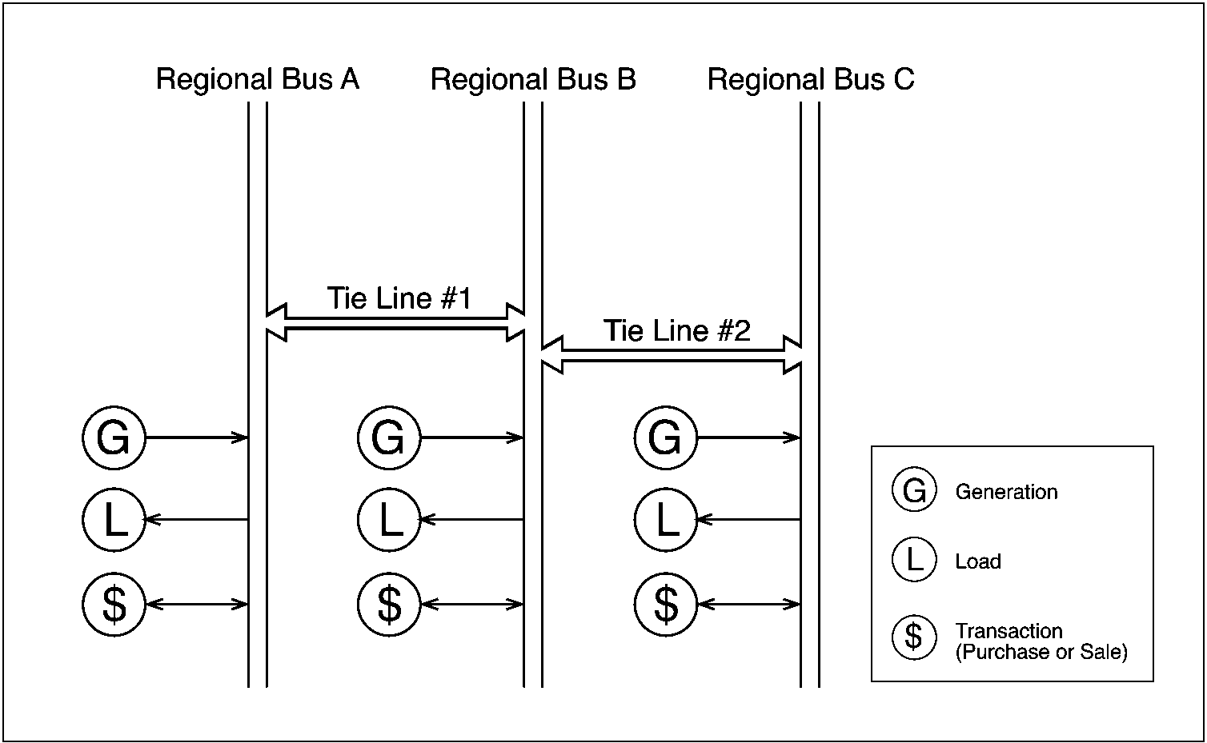
LT Vista Physical Model
Transmission System

Slide 20
Network Representation
Electric Network
  Continuity equation at node (bus)
  Σ MWin – ΣMWout = 0
  Losses through conveyance (tieline)
  MWout = Mwin - α.Mwin^2
MW Energy
MW ancillary service (reserve)

Slide 21
Physical Representation
Reserves and Generation
Unit/Plant Balance Equation
NON-SPINNING
NON_AGC
OPERATING
RESERVE
MAX MW
TOTAL SPINNING
LOAD FOLLOW.
SPINNING AGC
(Regulating)
CONTROL
MW
GENERATION
REG Down

Slide 22
Reserves: Basic Bus Model
Parallel network of Energy/ Reserves
bus reserve load energy balance, for each type
Res _{Tie in} -
Res _{Tie out}
Res _{Plants}
Res _{Bus}

Slide 23
Joint Optimization
  Energy and A/S markets with price forecasts
  Optimal trade-off between energy and A/S
Spin
Non Spin
Regulation Up
Regulation Down
Energy
Unused capacity can earn revenues with resulting unused water still sold as energy at a later date
Some of the unused capacity can be converted into energy when reserve is called (Take)

Slide 24
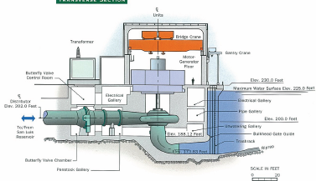
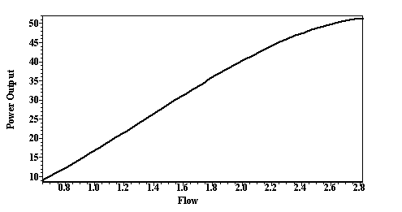
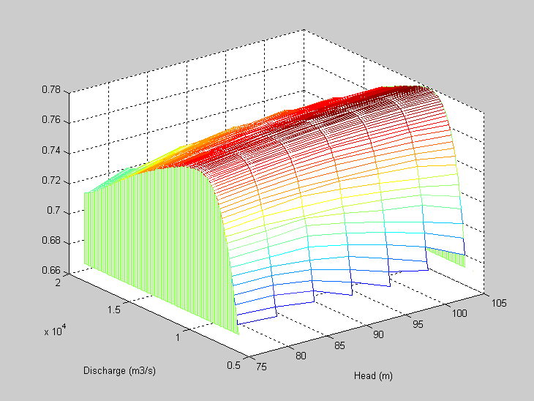
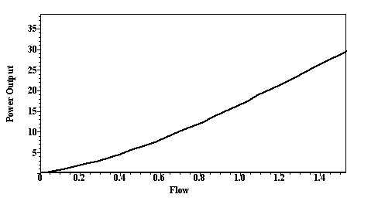
Physical Relations: Plants and Units
Power-flow-head relationship (3-D)
Notes:
Hatch’s manifesto

Slide 25
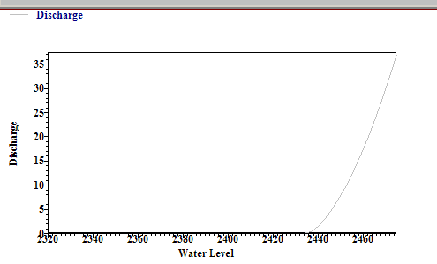
Spillway Equations
Q = C_{o} · L_{e} · Open · (hwl - E)^{Eo}
E = E_{sill} or twl
hwl
Submerged
Flow
Free Overflow
E_{Sill}
hwl
twl
E_{Sill}
Q = C_{f} · L_{e} · (hwl - E_{sill})^{Ef}

Slide 26
Operational Constraints Representation
Hydraulic Constraints
  Simple Constraints on Flow, storage (WL), MW
  Time aggregated constraints (linear)
    Max average
    Max/min between periods
  Relational constraints (including step functions)
Electric Constraints
  Simple Max/ Min on generation
  Tieline flow (congestion)
  Reserve (min/max)

Slide 27
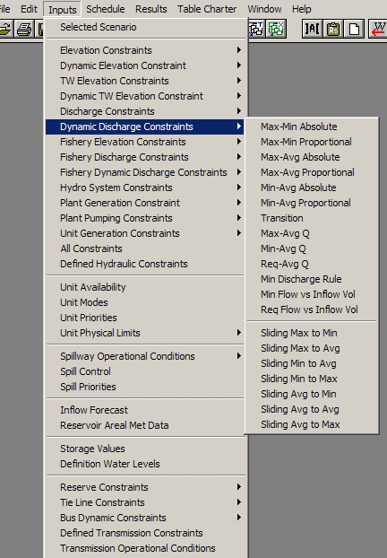
Operational Constraints Representation

Slide 28
Complexities in Formulation
Uncertainty
  Inflow
  Load
  Market price
Hydraulics
  Non-linear physical constraints
    generation with cross product (flow * head^a)
    Losses (quadratic)
    Spill representation
  Spatial/time connectivity
Discreteness
  Start/stop costs
  Spinning reserve
  Non continuous operating range
Large Scale
  Time dependent decisions (up to 200,000 decision variables / constraints)
Long Term
Short Term
Real Time

Slide 29
Preferred Schemes for Hydro
Linear Programming
Piecewise linearization
Successive Linearization
Semi-heuristics
Decomposition
Subproblems
Bender’s cuts
Dynamic Programming
Nonlinear Programming
Plants are hydraulically and electrically connected
  Water conveyance
  Load, reserve
Fixed amount of water over time – strong temporal interdependency

Slide 30
Long-term Planning

Slide 31
Long Term Model Principles
Consideration for Future Uncertainty
  Stochastic
Detailed Physical Representation
Simplified Time Definition
  Periods (week(s), month)
  Sub-period (peak, off-peak, weekend,…)
Time Average answers
Based on scenario analysis – consider all cross correlations

Slide 32
LT Vista Mathematical Model
Electric network:
  Buses
  tielines
Hydraulic network:
  arcs (plant, spill, river reaches)
  nodes (reservoirs, junctions)
Inputs:
- hydraulic: stochastic inflow, start/end WL
- electric: transactions, load
Engine
Stochastic SLP (2 stage)
Detailed Plant Operation
Detailed constraint set
Benders Decomposition
Constraints:
- hydraulic (flow, elevation, etc.)
- electric (transmission, etc.)

Slide 33
LT Vista Methodology
Two Stage LP
Decomposition Master 1st Period / Future period subproblem
Future 1
Future 2
NOW
Future 3
Future N

Slide 34
LT Vista Methodology
Multi-dimensional Uncertainty -- Inflow, Market and Load
Load
Market
H₁_M₂_L_{1_}
Hydrology
H₁_M₁
H₁_M₂_L₂
H₁_M₂
H₁
H₁_M₂_L₃
H₁_M₃
H₁_M₂_L_{l}
H₁_M_{m}

Slide 35
LT Vista Time Definition
Period:
  basic model time step (e.g., 1 week)
SubPeriod:
  Peak-off peak (Load duration) aggregation within periods
Time blocks
  constraints tying several periods/subperiods
subperiods
period
Time block

Slide 36
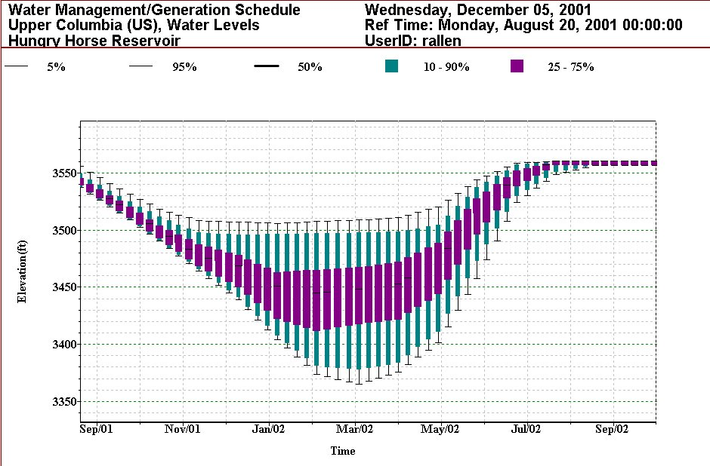
LT Vista Display – Probabilistic WL

Slide 37
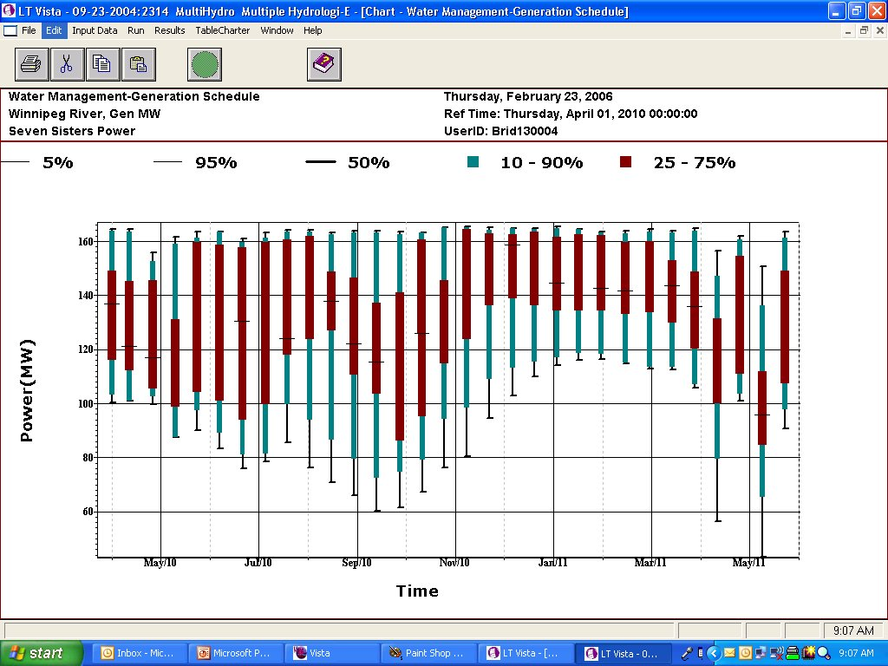
LT Vista Display – Probabilistic MW

Slide 38
Short-term Scheduling

Slide 39
Short Term Model Principles
Deterministic Model
Detailed Physical Representation
Detailed Hourly Time Definition
SLP numerical scheme with piecewise representation:
  MW/Flow relation
  Tieline losses
Unit Dispatch/Unit Commitment Subproblem
  Nonlinear Programming
  DP
Spinning reserve allocation subproblem
Integrated handshake with Long Term Model
Market Analysis

Slide 40
Unit Dispatch/ Unit Commitment Subproblem
Plant Representation based on optimal unit dispatch/ unit commitment around base solution
Plant Generation function used in SLP
Best Dispatch answers used in scheduling
General LP problem formulation cannot deal with discrete decisions – unit ON or unit OFF
Unit Dispatch
Model
Snapshot Non linear analysis
Fixed Head
Plant 1
Non continuous operation
Plant 2
Plant N

Slide 41
Spill Allocation
Aggregated spill representation
Piecewise linear representation
No flow zone
Sequencing issues – heuristic vs integer set
Stability issues
Spill 1
Spill 2
Spill N

Slide 42
LT – ST Handshake
Type
  Economic
    Seasonal Reservoirs: Value of water in storage applied to end of opt period water levels
    Other Reservoirs/head ponds: Max Target Water Levels at the end of opt period.
  Target Water Levels
    Seasonal Reservoirs: LT Target Levels applied to end of opt period water levels
    Other Reservoirs/head ponds: Max Target Water Levels at the end of opt period
  Target Flow Releases
    Seasonal Reservoirs: LT Target Levels applied to end of opt period water levels
    Other Reservoirs/head ponds: Max Target Water Levels at the end of opt period
Others
  meet target water levels defined by user
Custom
  Combination of above

Slide 43
Spinning Reserve Allocation Subproblem
Linearized formulation of spinning reserve
Subproblem is to find best unit allocation to meet spinning reserve requirements
LP Unit representation

Slide 44
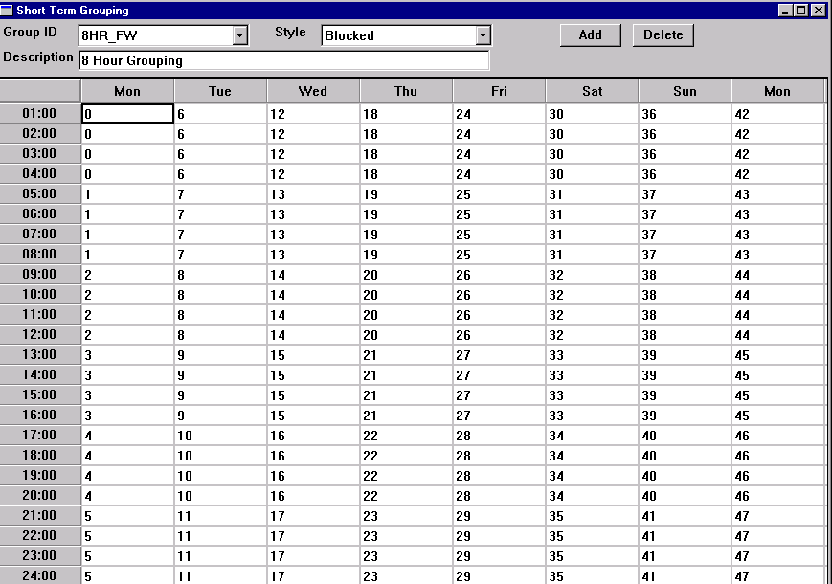
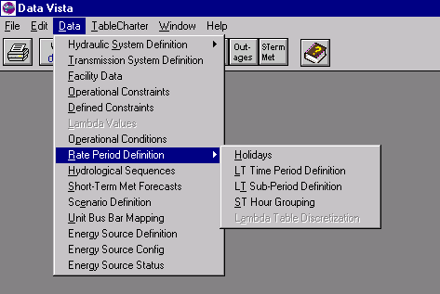
Reduction of Problem Size: User Defined Time Grouping

Slide 45
Total Bus Generation: Comparison between Time Groupings
4 hr
2 hr
8 hr

Slide 46
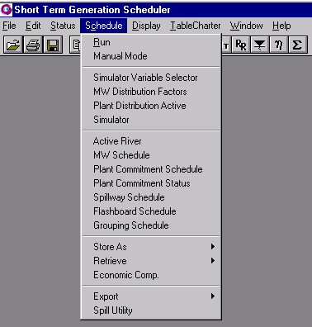
Reduction of Problem Size: ON/OFF River Status

Slide 47
ST Vista Run Times (866 MHz)
Day Ahead Study Period

Slide 48
Semi-Heuristic Resolution Schemes
Plant retirement/commitment
Plant zone resolution
Uncontrolled spillway structure
Semi-heuristic – does not cover all solution space
Perturbation to the LP global problem
MW
Flow

Slide 49
Price-Volume Curves
Methodology
Cost sensitivity calculation
Future
MW
Base
Storage
Dev
$
Time
MWh

Slide 50
Real Time Dispatch

Slide 51
Real Time Model Principles
Deterministic Model
Detailed Physical Representation
Detailed sub hourly Time Definition
Detailed Unit Dispatch/Unit Commitment Sub-problem
Integrated handshake with Short Term Model

Slide 52
Unit Commitment – Dispatch Rules
Minimum unit run time
Minimum unit down time
Maximum number of unit state changes in one time step
Unit start / stop costs
Dynamic unit status eligibility
    Unit availability
    Unit available for start
    Unit available for shutdown
    Unit fixed operations
Chosen algorithm – Dynamic Programming optimization

Slide 53
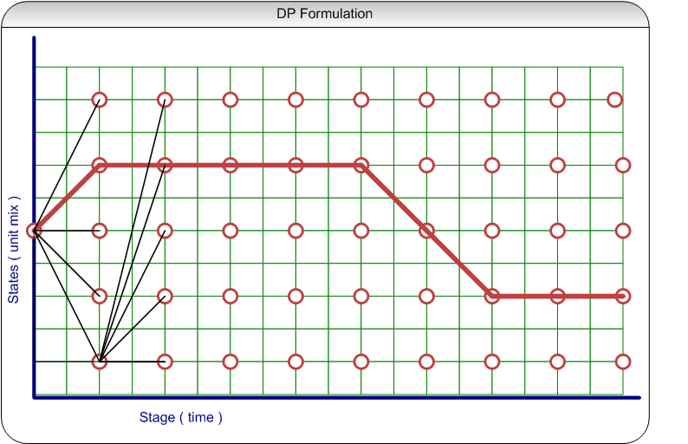
Unit Commitment – DP Formulation

Slide 54
Unit Commitment – DP Features
Only states derived from every time step, snap-shot, unit dispatch results are considered
Only eligible state paths are considered
Two cost components are evaluated
    State transition costs ( unit start / stop costs )
    State operation costs ( cost of water to meet generation requirements )
Objective function – minimize total dispatch cost

Slide 55
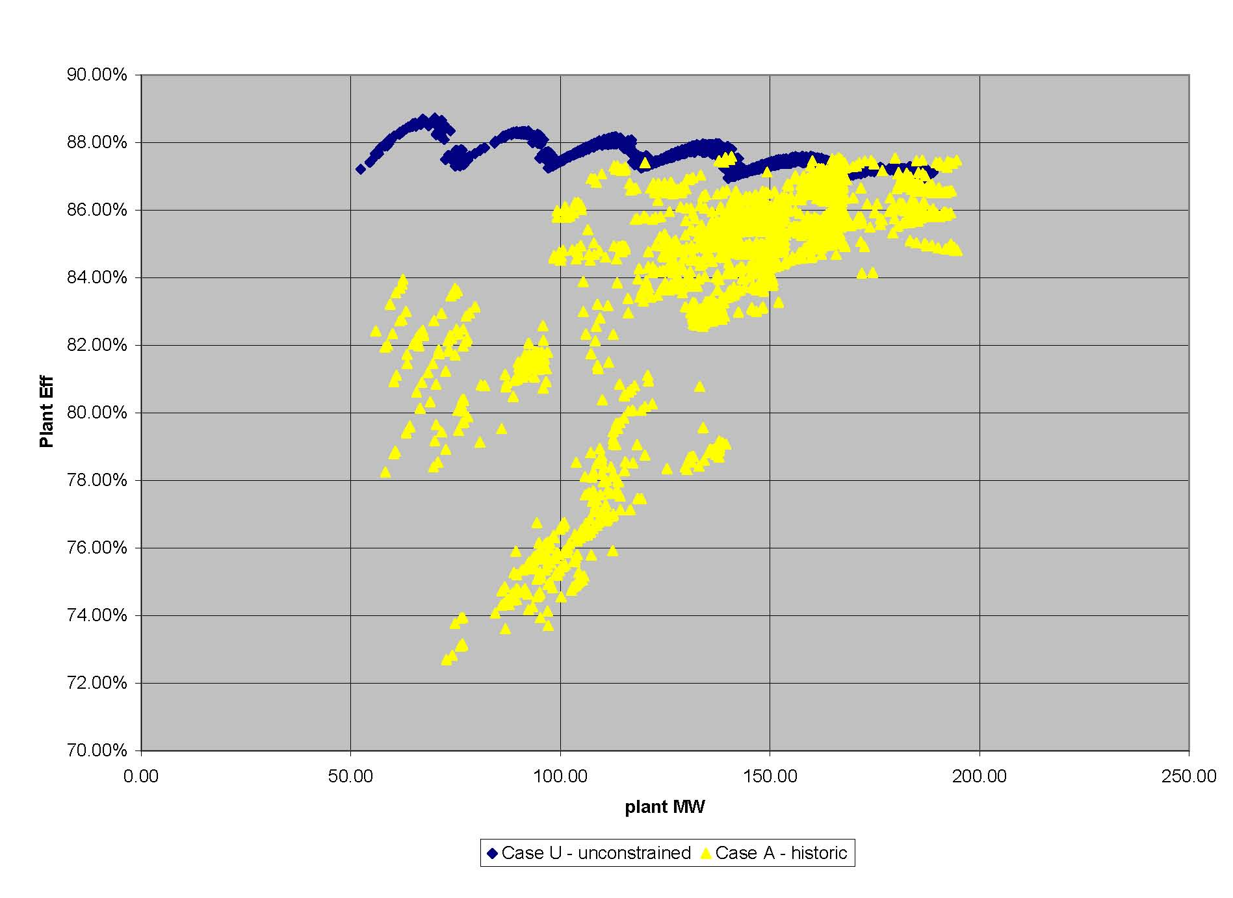
Efficiency Gains
After
Before

Slide 56
Conclusions
Future Trends and Developments
  Quality of Short Term Schedule
    Robustness/stability
  Expansion of market analysis
  Handling of uncertainty in Short Term scheduling
  Higher flexibility/performance in LT stochastic analysis

